Slide 1
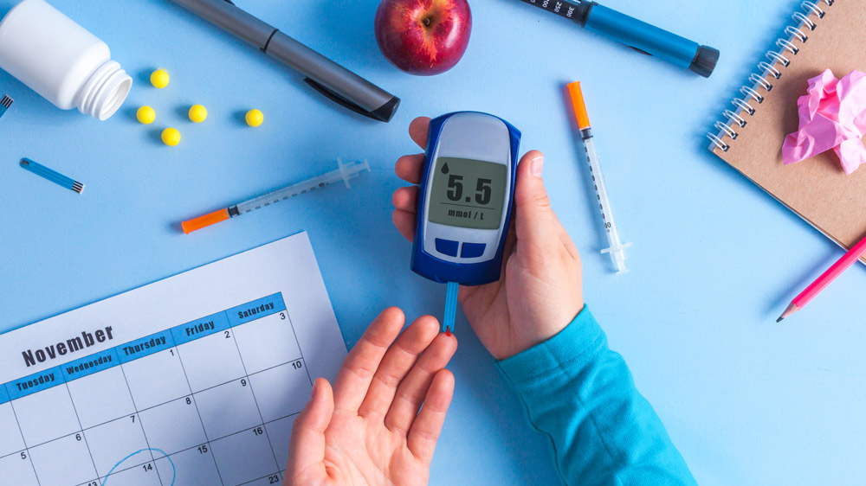
Predicting 30-Day Hospital Readmissions for Diabetic Patients
A Data-Driven Approach to Reducing Costs and Improving Outcomes
Manas Manish Nikte
MISM6200 | 11-19-2025

Slide 2
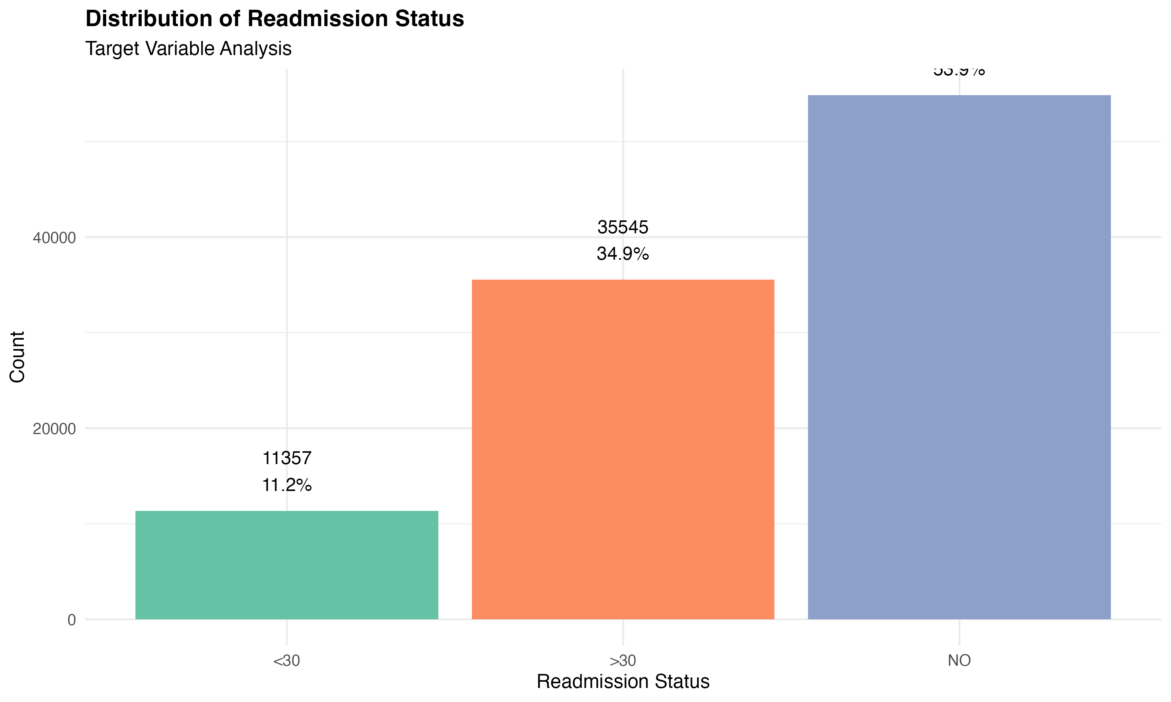
THE PROBLEM
The Challenge: 11.2% of diabetic patients readmitted within 30 days
The Cost: $10,000-$15,000 per readmission
The Goal: Identify high-risk patients for targeted intervention

Slide 3
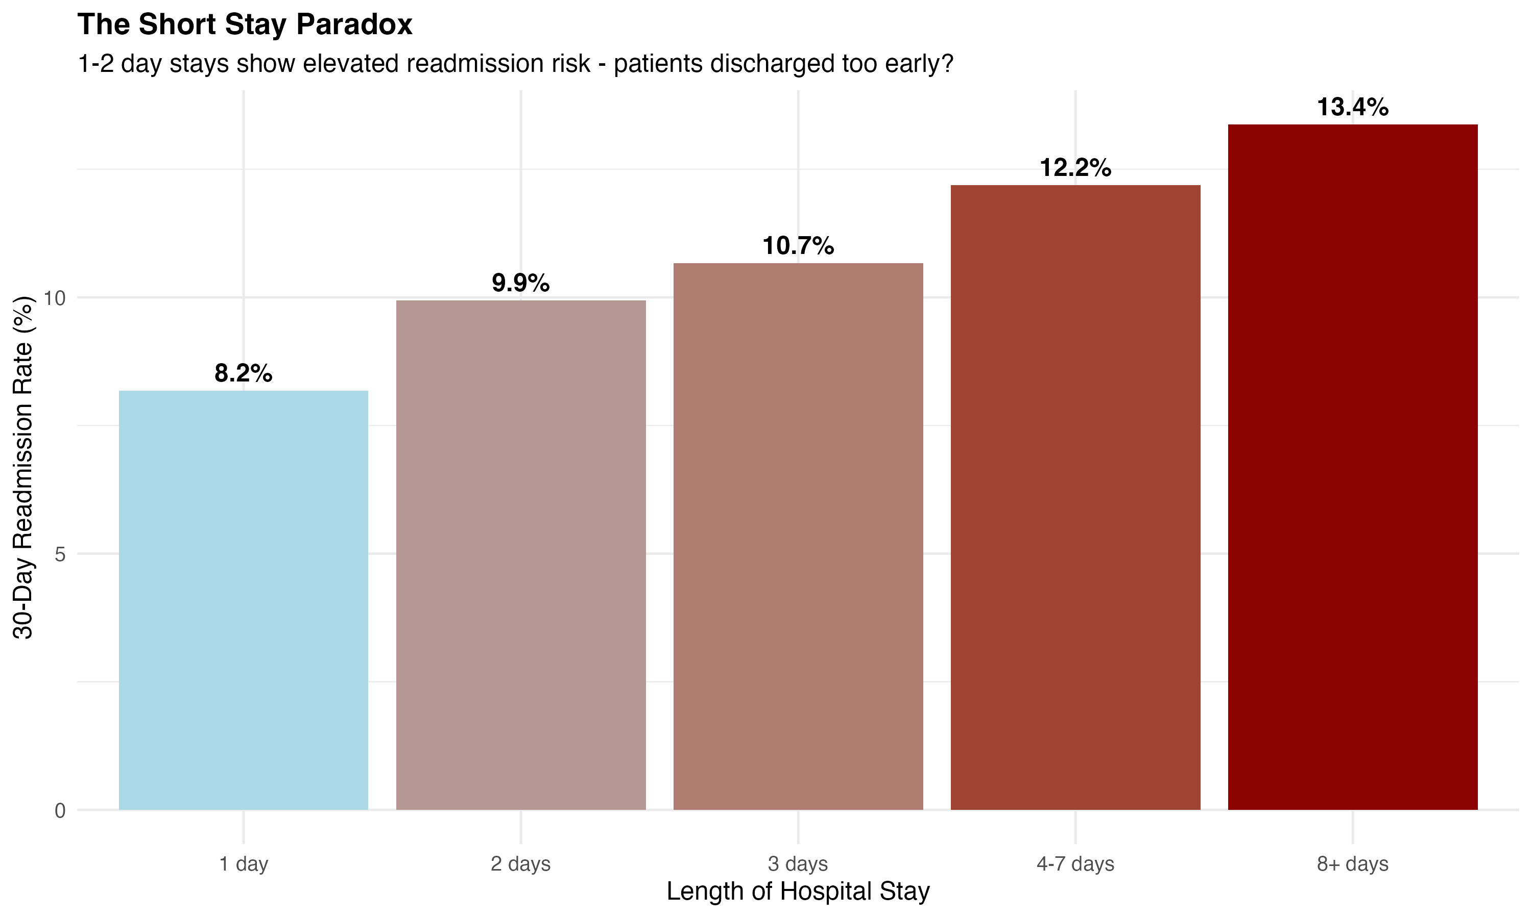
The Short Stay Paradox
Finding: 1-day stays have LOWEST risk (8.2%)
Question: Are 2-7 day patients discharged too early?
Action: Review discharge protocols

Slide 4
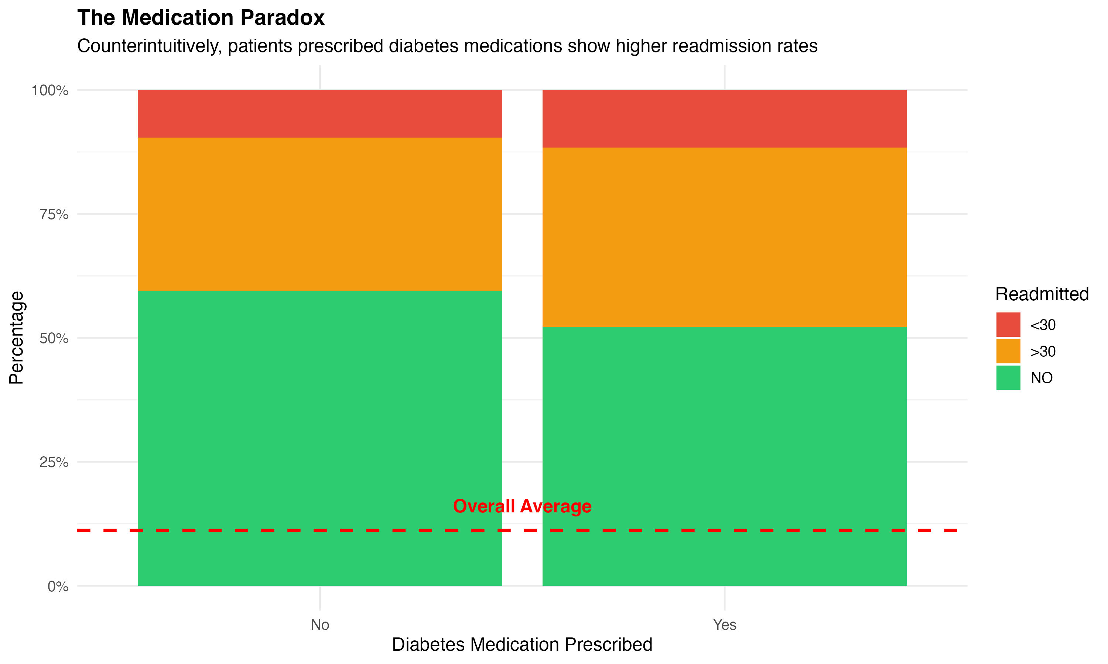
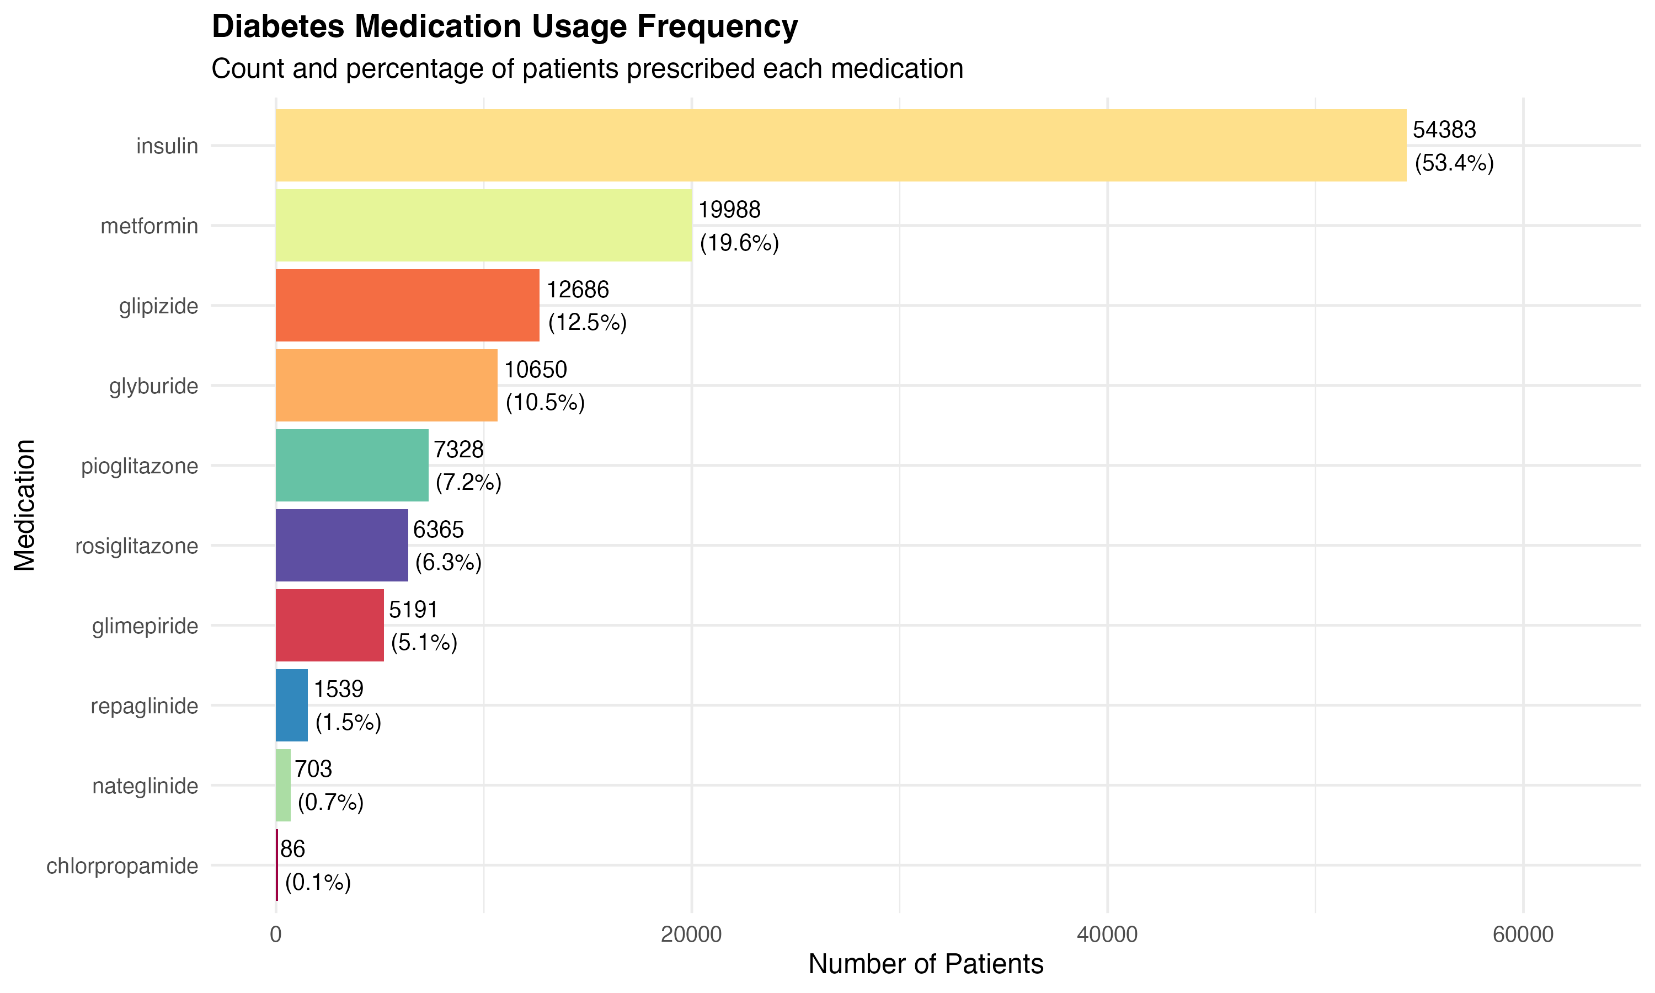
The Medication Paradox
Finding: Patients ON diabetes meds → Higher readmission
Why? Selection bias - sicker patients need more treatment
Insight: Insulin prescribed to 53% of patients

Slide 5
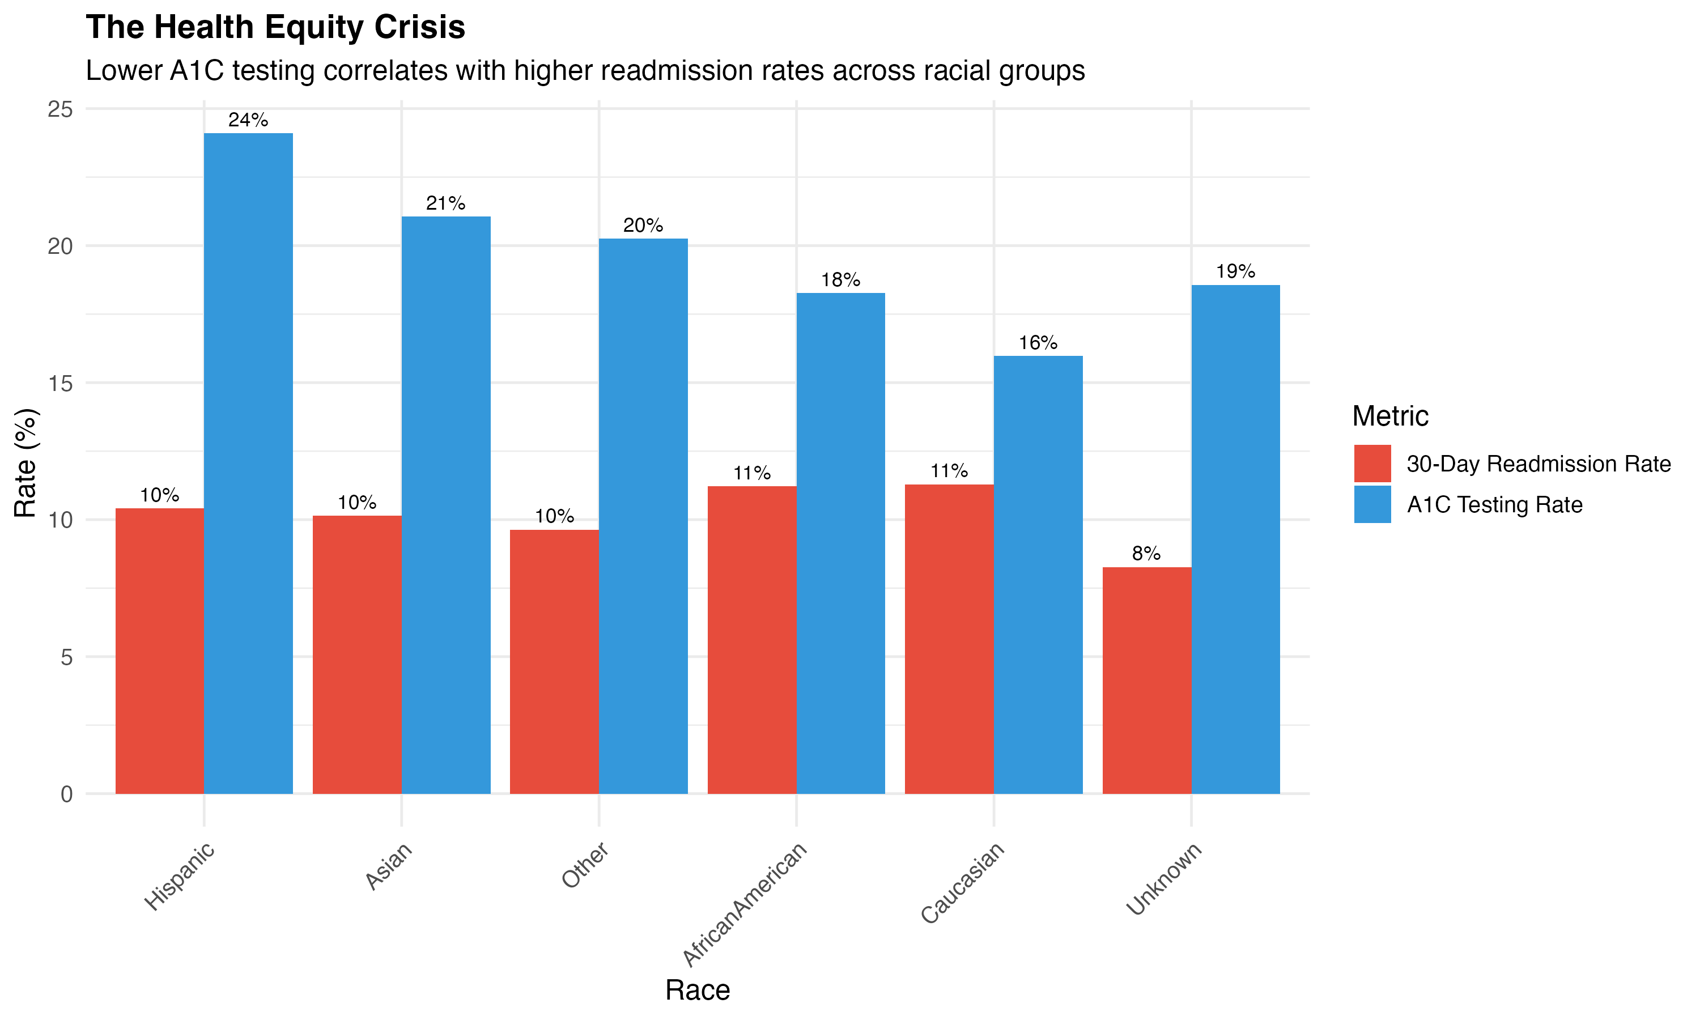
The Health Equity Crisis
Critical Finding: Lower A1C testing = Higher readmissions
  African American: 18% testing, 11% readmit
  Caucasian: 16% testing, 11% readmit
  Hispanic: 24% testing, 10% readmit
Gap: Systematic disparities in preventive care

Slide 6
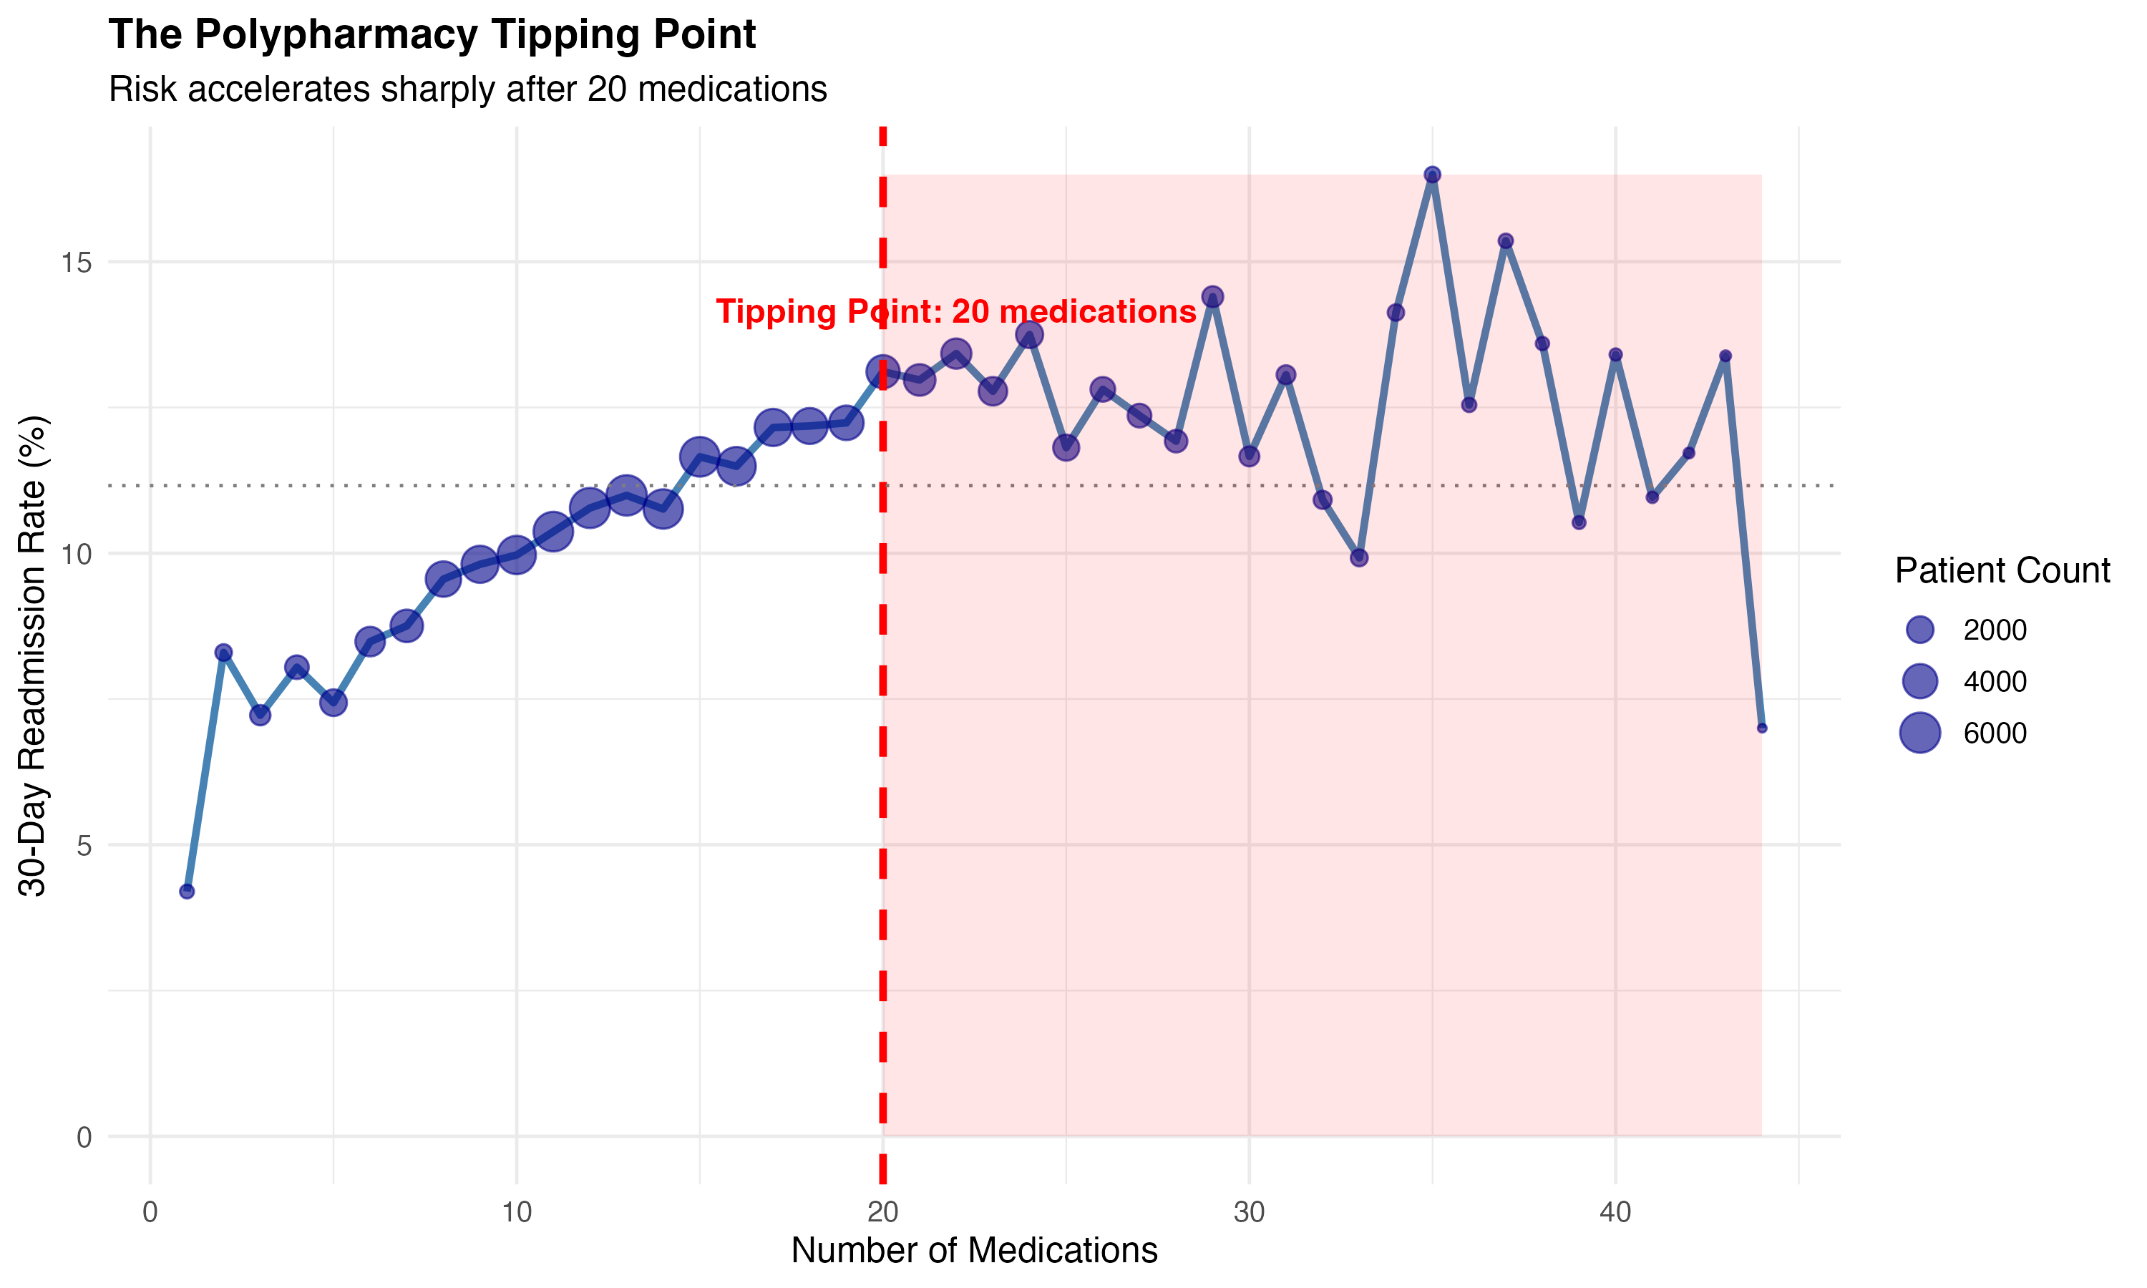
THE POLYPHARMACY TIPPING POINT
Clinical Threshold: 20 Medications
Below 20: Predictable risk (4% → 13%)
Above 20: Volatile, complex patients (10-16%)
Action: Flag for intensive case management

Slide 7
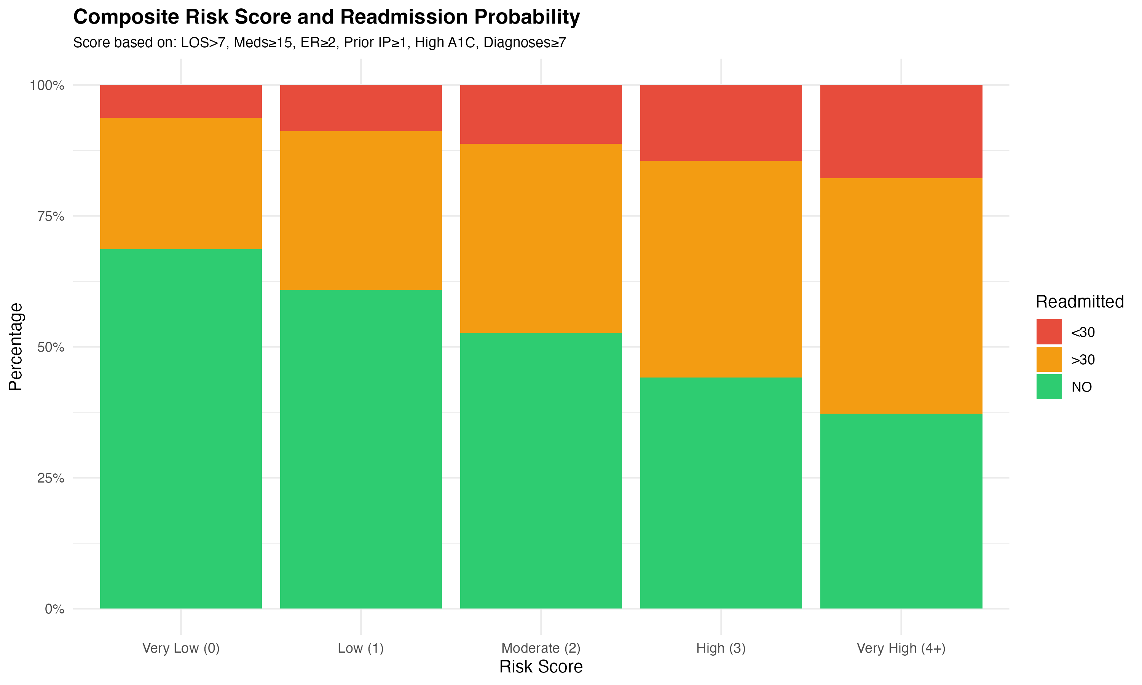
THE SOLUTION - RISK SCORE
LOS > 7 days = +1 point
Medications ≥ 15 = +1 point
Emergency visits ≥ 2 = +1 point
Prior inpatient stay = +1 point
High A1C = +1 point
Diagnoses ≥ 7 = +1 point
Results:
Very Low (0): 67% no readmit
Very High (4+): 35% no readmit, 21% <30 days

Slide 8
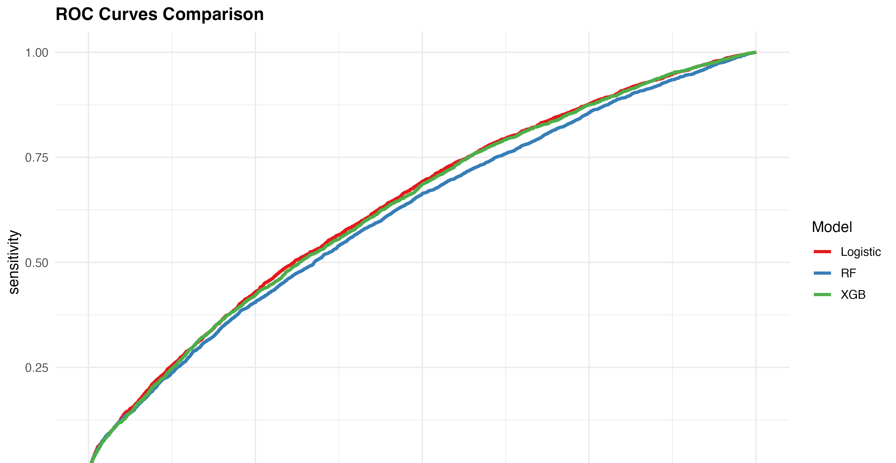
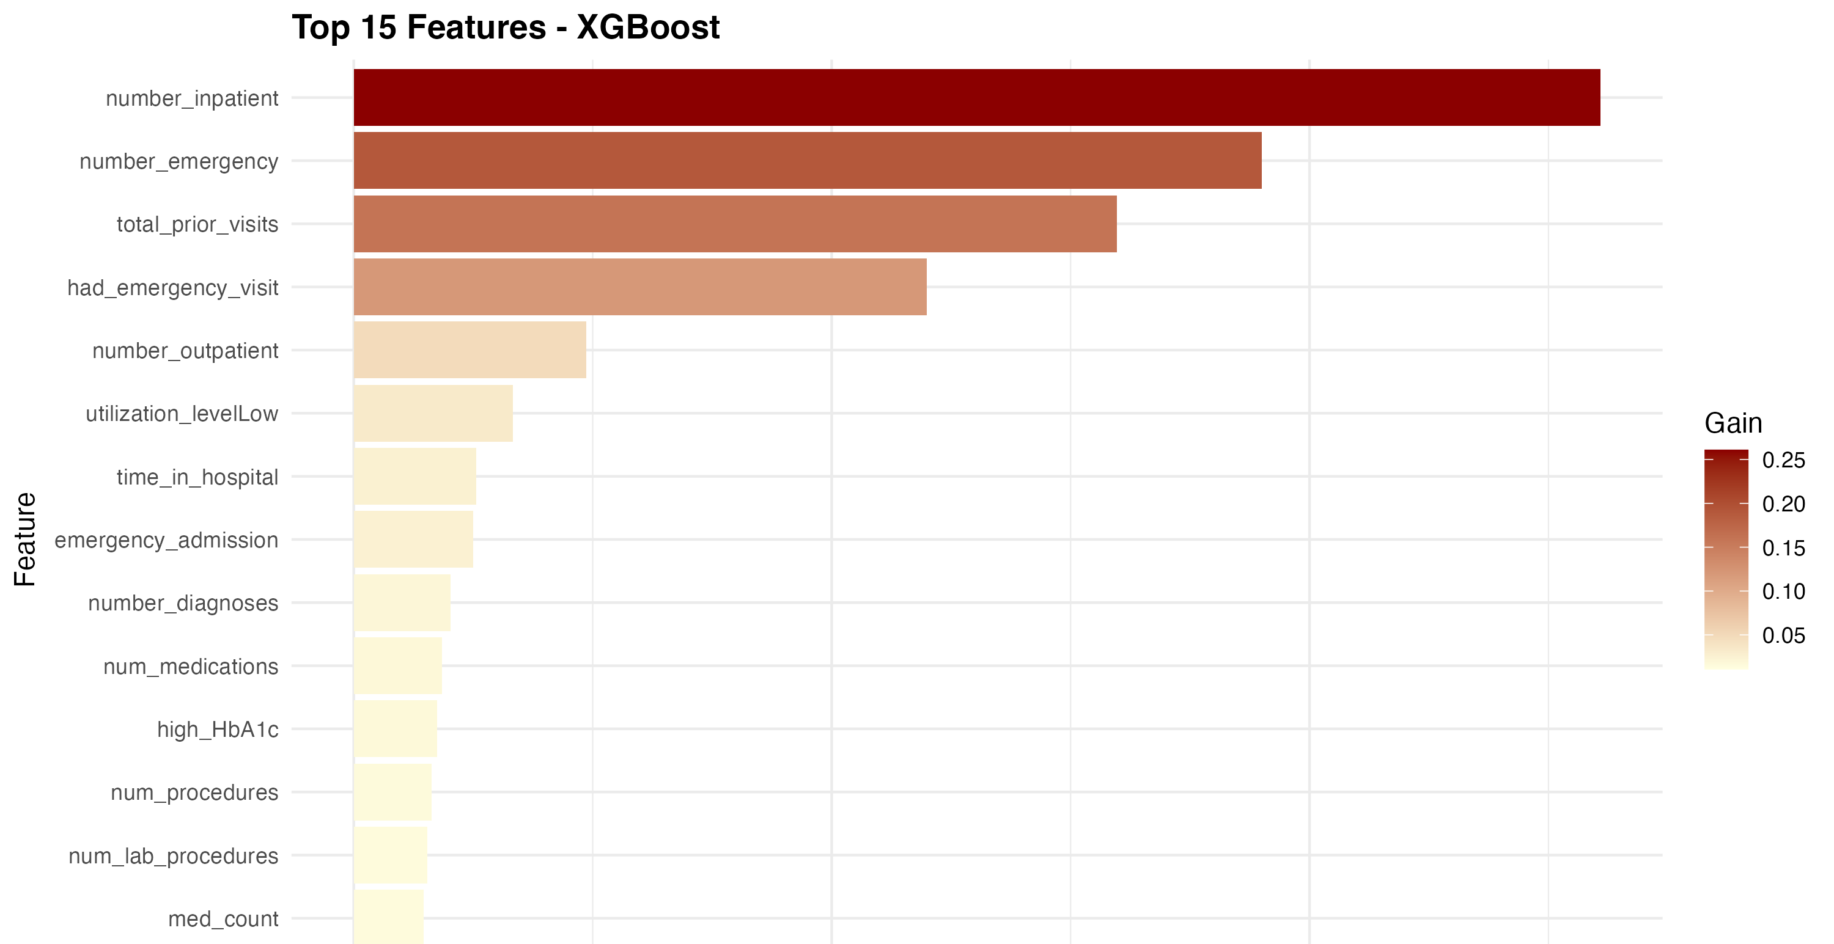
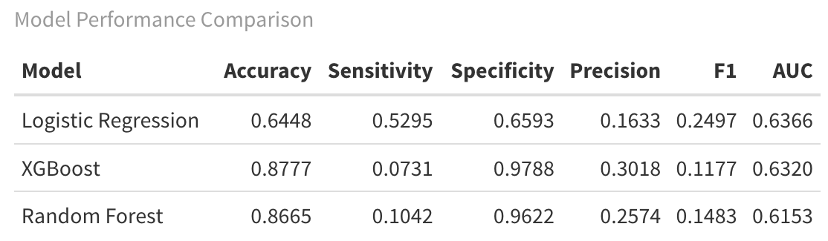
MODEL PERFORMANCE
Tested 3 algorithms: Logistic Regression, Random Forest, XGBoost
Performance: 61-64% AUC across all models
Top Predictors: Prior inpatient visits, emergency visits, total utilization

Slide 9
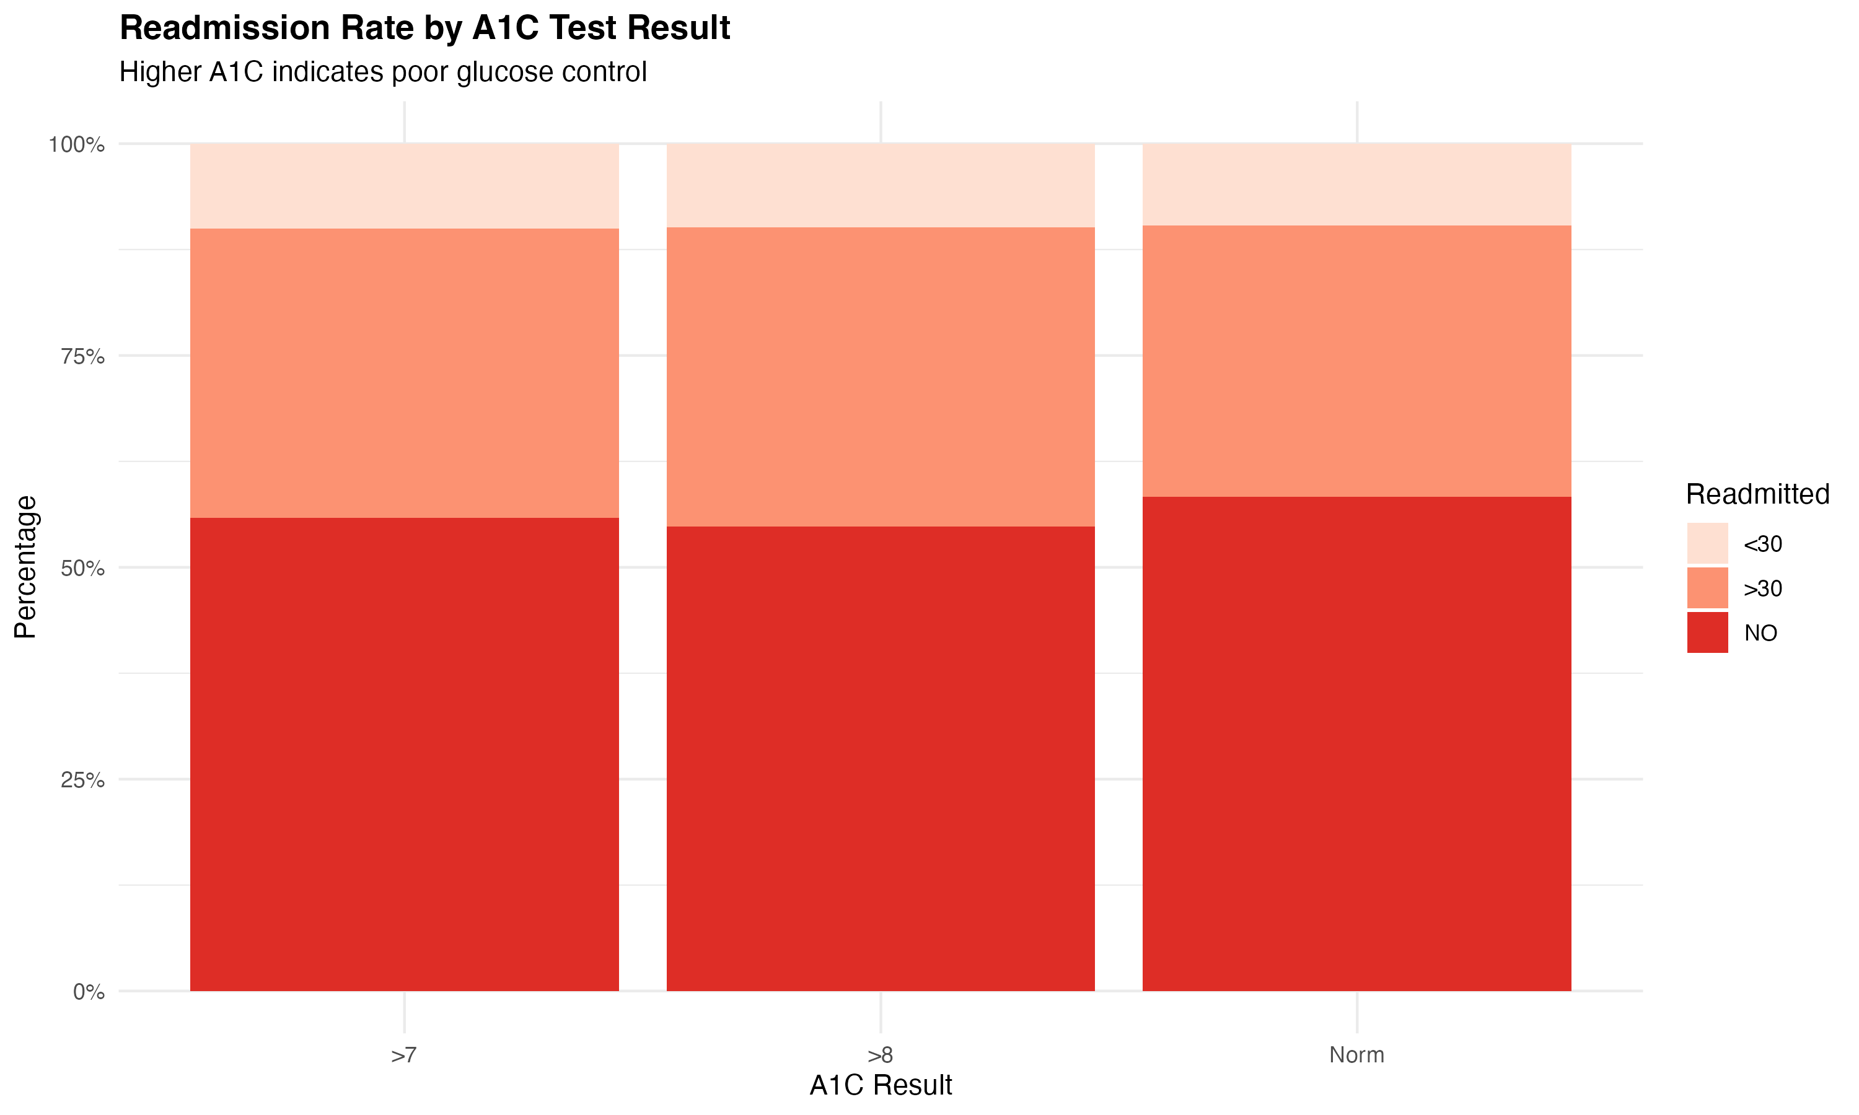
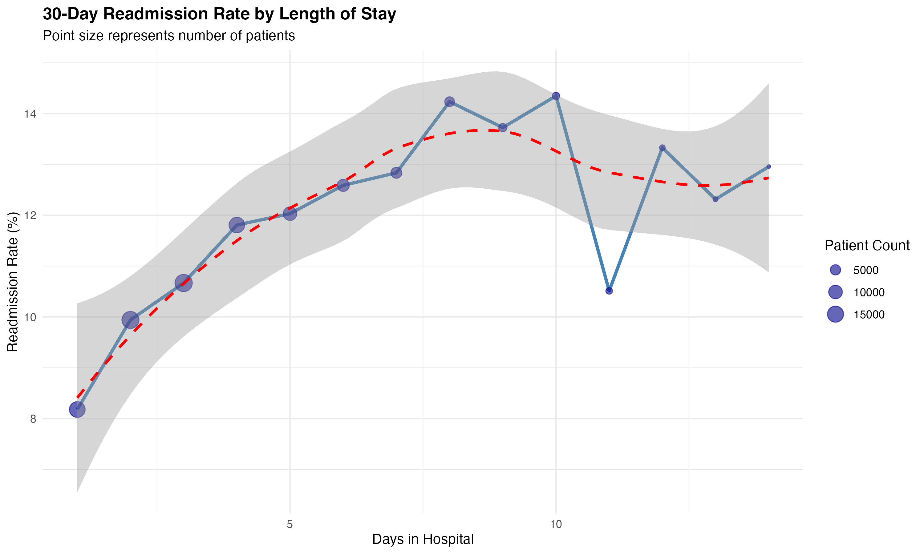
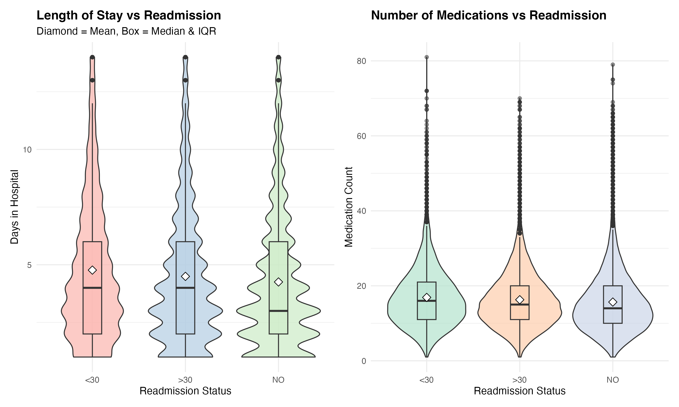
BUSINESS IMPACT & RECOMMENDATIONS
Immediate Actions:
✅ Mandate A1C testing for ALL diabetic admissions
✅ Flag patients with 20+ medications for pharmacy review
✅ Use risk score to triage discharge resources
✅ Address racial disparities in preventive care
Expected Outcomes:
📉 20-30% reduction in 30-day readmissions
💰 $500K - $1M annual savings per hospital
😊 Improved patient outcomes
⭐ Better CMS star ratings

Slide 10

Thankyou!
Any Questions?
Scan to access the GitHub Repository

